Slide 1
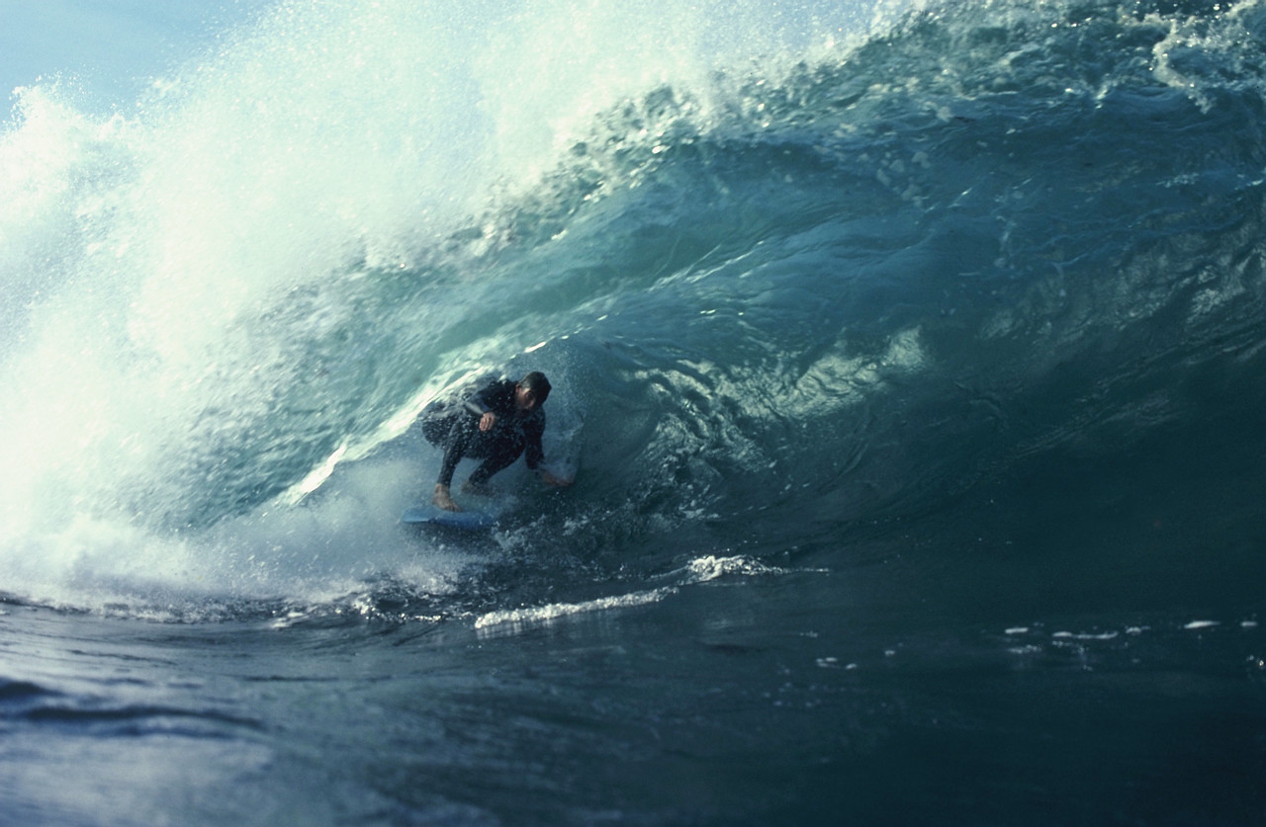
Poetry Elements
Terms that must be learned and applied when analyzing poetry!

Slide 2
What is Poetry?
Poetry might be defined as a kind language that says more and says it more intensely than does ordinary language.
It makes ordinary experiences into life experiences for all

Slide 3
Poetry is universal
Poetry is as universal as language and almost as ancient.
Why?
1) Poetry gives pleasure and enjoyment.
2) It is regarded as important because it has a unique value in fully realizing life.

Slide 4
Experience
A poet is concerned with experience. Poets, from their own store of felt, observed, or imagined experiences, select, combine and reorganize. They create significant new experiences for their readers in which to participate and gain greater understanding and awareness of their world.

Slide 5
Poetry can come from any experience
An experience can be an every day one such as looking at a building.
Poetry can also come from the extraordinary.

Slide 6
Example of experience by great poets…
Watching an eagle or some form of nature…..
“The Eagle” by Alfred, Lord Tennyson
He clasps the crag with crooked hands;/Close to the sun in lonely lands,/Ringed with the azure world, he stands.
The wrinkled sea beneath him crawls;/ He watches from the mountain walls,/ And like a thunderbolt he falls.
Readers will feel that they have enjoyed a significant experience and understand eagles better, though in a different way than they did from an encyclopedia article. This is because an article analyzes an experience with an eagle and the poem synthesizes the experience.

Slide 7
How to read a poem
1. Read a poem more than once. A reader cannot get the full meaning in one reading.
2. Keep a dictionary by you and use it. You must know the meaning of the words in a poem.
3. Read so as to hear the sounds of the words in your mind.
Poetry is written to be heard!
4. Always pay careful attention to what the poem is saying.
5. Practice reading poems aloud.

Slide 8
Speaker
The speaker is the voice in a poem that “talks” to the reader, similar to the narrator in fiction.
The speaker is not necessarily the same as the poet, although in some cases it may be.
Sometimes, a poet will create a speaker with a distinct identity in order to achieve a certain effect.
First, identify the speaker! (#2)

Slide 9
Identify the speaker and what he or she is saying.
What I Know
What is the poem saying explicitly?
What I Infer
What is implied in the poem?
Speaker

Slide 10
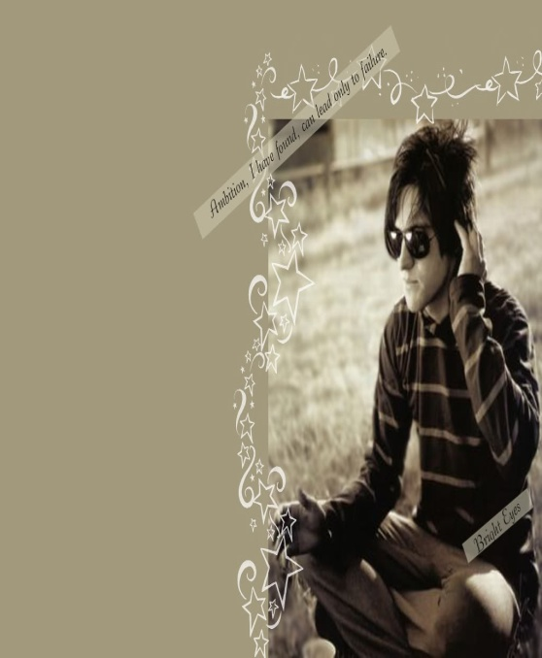
Tone
The attitude a writer takes toward the reader, a subject, a character, or himself. (#29)
It is the emotional coloring, or the emotional meaning, of the work and is an extremely important part to the meaning of the poem.
The tone of a poem can be playful, solemn, mocking, reverent, calm or excited.

Slide 11
Example of Tone
“For the Lamb” by Richard Eberhart
I saw on the slant hill a putrid lamb, / Propped with daisies. The sleep looked deep. / The face nudged in the green pillow/ But the guts were out for crows to eat.
Where’s the lamb? whose tender plaint/ Said all for the mute breezes./ Say he’s in the wind somewhere,/ Say, there’s a lamb in the daisies.
Tone – The reader shares the speaker’s sad acceptance of reality. The lamb represents innocence, youth, and play. However, the word “putrid” shocks the speaker because the lamb is now left for scavengers. The speaker tries to overcome this shock in the 2nd stanza by relating the truth the lamb still represent purity and innocence in nature. The lamb will be transformed to become part of the daisy field.

Slide 12
What is the tone of this poem?
“We Real Cool” by Gwendolyn Brooks
We real cool. We
Left school. We
Lurk late. We
Strike straight. We
Sing sin. We
Thin gin. We
Jazz June. We
Die soon.
Give words or lines from the poem that support your answer.

Slide 13
Denotation and Connotation
A primary distinction between the practical use of language and the literary use is that in literature, especially in poetry, fuller use is made of individual word.
The composition of a word has three parts:
Notation – the combination of tones and noises uttered by the lips, tongue, and throat. (huh-o-mmm)
Denotation – the dictionary meaning of the word. Example: The word home means only a place where one lives.
Connotation – what the word suggests beyond what it expresses: the overtones of meanings. Example: The word home suggest security, love, comfort, and family. (#18 &18A)

Slide 14
Denotation and Connotation
Choose a word. Write the denotation of the word.
Now write as many connotations for that word that you can think of….

Slide 15
Imagery
Imagery is the representation through language of sense experience.
Imagery is how poets connect readers, through their senses, with what is written in poem.
The senses: visual, auditory, olfactory (smell), taste, and touch.
Examples: “The gray sea and the long black land…” (visual)
“…slushy sand between my toes.” (touch)
“…a voice less loud…” (auditory)
“…the smell of warm bread fills the kitchen” (olfactory)
“The salty water burned my throat.” (taste) #1

Slide 16
Using the senses, write down words that describe this picture….

Slide 17
Using the senses, write down words that describe this picture….

Slide 18
Figurative Language
Figurative language-language using figures of speech- is language that cannot be taken literally, or should not be taken literally only.
A figure of speech is any way of saying something other than the ordinary way, or a way of saying one thing and meaning another. (#35 & 36)

Slide 19
Metaphor
A figure of speech that makes a comparison between two seemingly unlike things without using the connective words like, as, than, or resembles. (#6)
Spring by William Shakespeare
When daisies pried and violets blue,/
And lady-smocks all silver-white…
Shakespeare is comparing spring flowers with women’s clothing.

Slide 20
Write a metaphor from viewing this picture.

Slide 21
Simile
A figure or speech that makes a comparison between two seemingly unlike things by using like, as, than, or resembles. (#7)
The Guitarist Tunes up by Frances Cornford
With what attentive courtesy he bent/Over his instrument;/Not as a lordly conqueror who could/Command both wire and wood,/But as a man with a loved woman might,/Inquiring with delight/What slight essential things she had to say/Before they started, he and she, to play.
The speaker is comparing the guitarist love and skill for playing his guitar with that of a man who is in love with a woman.

Slide 22
Write a simile using this picture.

Slide 23
Extended Metaphor
A metaphor that is extended or developed several lines of writing or even throughout an entire poem (#6A)
Example: The Hound by Robert Francis
Life the hound/ Equivocal/ Comes at a bound/ Either to rend me/ Or to befriend me.
I cannot tell/ The hound’s intent/Till he has sprung/At my bare hand/With teeth or tongue/Meanwhile I stand/And wait the event.
This is a metaphor comparing life, where one does not know what event will be good or bad, to that of a hound who can either come up and bite someone of lick his or her hand. It is an extended metaphor because the entire poem uses the metaphor of comparing events of life to an either friendly or evil animal.

Slide 24
……Assignment
Metaphors can be named or implied. For this poem, the literal term is named, hound, and the figurative term is implied, life.
Find a poem that is an example of an extended metaphor.

Slide 25
Personification
A kind of metaphor in which a non-human thing or quality is talked about as if it were human
“Out in the porch’s sagging floor/ Leaves got up in coil and hissed.” (#8)

Slide 26
.
Write a paragraph on each giving these subjects personification

Slide 27
Synecdoche and Metonymy
Synecdoche is the use of the part for the whole.
Example: “The Hippocratic eye will see/In nakedness, anatomy…” The poet uses Hippocratic to represent a doctor. (#37)
Metonymy is the use of something closely related for the thing actually meant.
Example: … “as if to keep / The life from spilling,” in which the poet literally means to keep the blood from spilling. (#38)

Slide 28
Apostrophe
An apostrophe is addressing someone who is absent or dead, or something nonhuman as if that person or thing were present and alive and could reply to what the speaker is saying.
Example: Western wind, when wilt thou blow,
The small rain down can rain?
Christ! If my love were in my arms,
And I in my bed again! (Anonymous)
The speaker is addressing the wind.

Slide 29
Symbol
A person, place, thing, or event that stands for itself and something beyond itself #(40)
As in “The Road Not Taken,” by Robert Frost, the reader realizes that the road is a symbol that represents any choice in life between alternatives.

Slide 30
What do these symbols mean?
Make four symbols of your own and tell what they represent?

Slide 31
Allegory
Allegory is a narrative or description that has a second meaning beneath the surface. (41)
Allegory is less popular in modern literature than it was in medieval and Renaissance, and it is much less often found in short poems than in long narrative works such as The Faerie Queene, Everyman, and Pilgrim's Progress.

Slide 32
Allusion
A reference to a statement, person, place, event, or thing that is known from literature, history, religion, myth, art, politics, sports, science, etc. (#30)
Example: “Her garden was a competitor to The Garden of Eden.”
The Garden of Eden is an allusion to the Biblical story of Adam and Eve

Slide 33
Write down some allusions you may have heard used by yourself or others.
Religious allusions?
Science? Literature?

Slide 34
Oxymoron
Two words used together which seem to be in contradiction (#42)
Sweet and sour
Thunderous silence
Prehistoric history
Can you think of more….?

Slide 35
Onomatopoeia
The use of a word whose sound imitates or suggest its meaning (#28)
Ding, ding, ding
Clank
Whoosh
What others do you know?

Slide 36
Hyperbole and Understatement
Hyperbole is a figure of speech that uses exaggeration to express strong emotion or create a comic effect. (#43)
“I’ll die if I don’t pass this course!”
“I’m starved!”
“You could have knocked me over with a feather.”
Understatement is saying less than one means. (#44)
Like stating, "This looks like a nice snack” when one is looking at a table full of food.
Write a few hyperbole and understatements!

Slide 37
Paradox
Paradox is an apparent contradiction that is nevertheless somehow true. It may be either a situation or a statement.
“damn with faint praise”
“cold hands and hot porridge”
“fire and ice”
The value of paradox is its shock value
Can you thing of more…?

Slide 38
Musical Devices
Alliteration: The repetition of initial consonant sounds in words that are close to one another. (#27)
“Western wind, when wilt thou blow…”
Assonance: The repetition of vowel sounds. (#46)
“mad as a hatter,” “time out of mind,”
“free and easy”
Consonance: The repetition of a final consonant sounds. (#47)
“first and last,” “odds and ends,” “short and sweet,”
“a stroke of luck,” “struts and frets”

Slide 39
Assignment
Find examples of alliteration, assonance, and consonance.

Slide 40
Rhythm
Rhythm refers to any wavelike recurrence of motion or sound. (#10)
Hiawatha's Departure from The Song of Hiawatha by Henry Wadsworth Longfellow
By the shore of Gitchie Gumee, By the shining Big-Sea-Water, At the doorway of his wigwam, In the pleasant Summer morning, Hiawatha stood and waited.

Slide 41
METER
Meter is the kind of rhythm we can tap our foot to. Meter comes from the word measure. (#9)
Metrical language is called verse.
Nonmetrical language is call prose.
Not all poetry is metrical, nor is all metrical language poetry.

Slide 42
Metrical
In every word of more than one syllable, one syllable is accented or stressed, that is given more prominence in pronunciation than the rest. (50)
inter, enter, intervene, enterprise, interpret
These accents are indicated in the dictionary.
If words of even one syllable are arranged into a sentence, we give certain words or syllables more prominence.
We say: “He went to the store.”
“Ann is driving her car.”

Slide 43
Structure (#3)
A Poetry Form is the general organizing principle of a literary work.

Slide 44
Metrical Units
Foot is the basic metrical unit that consists normally of one accented syllable plus one or two unaccented syllables, though occasionally there may be no unaccented syllables, and very rarely there may be three. (#13)
Line is the secondary unit of measurement that is measured by naming the number of feet in it. (26A)
Monometer one foot
Dimeter two feet
Trimeter three feet
Tetrameter four feet
Pentameter five feet
Hexameter six feet
Heptameter seven feet
Octameter eight feet

Slide 45
Metrical Units continued
Stanza is the third unit of measurement that consists of a group of lines whose metrical pattern is repeated throughout the poem. (#5)
Not all verse is written stanzas.
Scansion is the process of measuring verse. (#14)
To scan any specimen of verse, we do three things:
1) identify the prevailing foot
2) name the number of feet in a line – if this length follows any regular pattern
3) describe the stanza pattern – if there is one.

Slide 46
Rhyme
Rhyme: repetition of the same sound. (21)
Rhyme scheme: a regular pattern of end rhyme in a poem.(22)
Exact Rhyme - is when the later part of the word or phrase is identical sounding to another.
End Rhyme- the use of rhyming words at the ends of lines.
Internal rhyme: use of rhyming words within lines
Slant Rhyme- use of rhyming sounds that are similar but not identical, as in rave and rove or rot and rock. (consonance is a type of slant rhyme).

Slide 47
Couplet: two lines of poetry that usually rhyme.
Avocado Girl
By: Ms. Aixa B. Rodriguez
I am an ahuacatl of ancient days,
Of both past and present ways.
I am an aguacate of a familiar green,
A nuyorbronxrican Queen.
I am an avocado with rough Bronx skin,
both Latina and American.

Slide 48
Try your skill on the following poem. Virtue by George Herbert
Sweet day, so cool, so calm, so bright,
The bridal of the earth and sky;
The dew shall weep thy fall to night,
For thou must die.
Sweet rose, whose hue, angry and brave,
Bids the rash gazer wipe his eye;
Thy root is ever in its grave,
And thou must die.
Sweet spring, full of sweet days and roses,
A box where sweets compacted lie;
My music shows ye have your closes,
And all must die
Only a sweet and virtuous soul,
Like seasoned timber, never gives
But though the whole world turn to coal,
Then chiefly lives.

Slide 49
Answer these questions of the previous poem…
1) Vocabulary: bridal (2), brave (5), closes (11)
How are the four stanzas interconnected?
How do the stanzas build to a climax?
How does the fourth stanza contrast with the first three?

Slide 50
Types of Poetry
Narrative Poetry- a narrative poem is one that tells a story. Types of narrative poetry include ballads and epics. (17)
Lyric Poetry- a highly musical verse that expresses the emotions of the speaker. Common types are sonnets, odes, free verse and elegies. (33)
Dramatic poetry- a dramatic poem is a verse that relies heavily on dramatic elements such as monologue, or dialogue. Two types of dramatic poetry are dramatic monologue and soliloquy. (#48)

Slide 51
More poetry……
Epic : a long narrative poem centering on a heroic figure who represents the fate of a nation. (#49)
Ballad: a narrative poem, sometimes sung, that tells a dramatic story. (#32)

Slide 52
Free verse : poetry with no set rhythm or rhyme. (#15)
eye rhyme. n. A rhyme consisting of words, such as lint and pint, with similar spellings but different sounds. Also called sight rhyme
Slant rhyme in which either the vowels or the consonants of stressed syllables are identical, as in eyes, light; years, yours

Slide 53
Types of Poetry
Haiku: a three-line poem usually about nature, with this syllable pattern: 5,7,5. This style originated in Japan
Narrative Poetry- a narrative poem is one that tells a story. Types of narrative poetry include ballads and epics.
Lyric Poetry- a highly musical verse that expresses the emotions of the speaker. Common types are sonnets, odes, free verse and elegies.
Dramatic poetry- a dramatic poem is a verse that relies heavily on dramatic elements such as monologue, or dialogue. Two types of dramatic poetry are dramatic monologue and soliloquy.
Epic : a long narrative poem centering on a heroic figure who represents the fate of a nation.
Ballad: a narrative poem, sometimes sung, that tells a dramatic story.
Free verse : poetry with no set rhythm or rhyme.

Slide 54
Concrete Poetry
A concrete poem is one that takes the shape of the object it describes Choose an object in the room in which you’re writing. It may be a picture, a vase, the television set, or a computer. This can be the topic of your poem. Consider the object. Brainstorm a list of words and phrases that describe the object, and anything else that comes to mind when considering the object you’ve selected as the subject of the poem. List any special significance, events, or elements of the object. Does the object remind you of someone or perhaps special time in your life? A vase of flowers, for example, may remind you of your grandmother’s garden or your mother’s prized roses. List any associations that come to mind. Now take a blank sheet of paper. Sketch an outline or image of the object. Begin fitting the words and verses into the outline you’ve sketched. They shouldn’t feel contrived, but rather flow as poetry. When your poem says what you wish it to say, you may wish to go back and erase the sketch so that the words themselves stand out on the paper in their new visual form.
Concrete Poetry

Slide 55
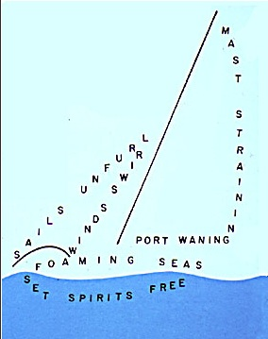
Concrete Poetry

Slide 56
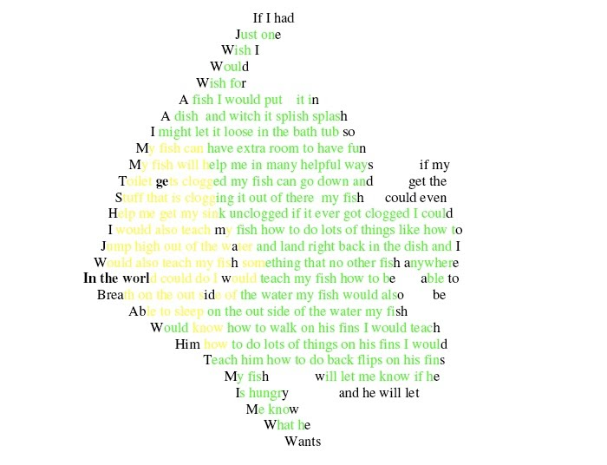
Concrete Poetry

Slide 57
Haiku
"Haiku" is a traditional form of Japanese poetry. Haiku poems consist of 3 lines. The first and last lines of a Haiku have 5 syllables and the middle line has 7 syllables. The lines rarely rhyme.
Here's a Haiku to help you remember:
I am first with five Then seven in the middle -- Five again to end.

Slide 58
Haiku Examples
Basho Matsuo
Here are two examples of the haiku of Basho Matsuo, the first great poet of haiku in the 1600s:
An old silent pond...
A frog jumps into the pond,
splash! Silence again.
Autumn moonlight—
a worm digs silently
into the chestnut.

Slide 59
Lyric Poetry
Definition of Lyric Poetry
Lyric Poetry consists of a poem, such as a sonnet or an ode, that expresses the thoughts and feelings of the poet. The term lyric is now commonly referred to as the words to a song. Lyric poetry does not tell a story which portrays characters and actions. The lyric poet addresses the reader directly, portraying his or her own feeling, state of mind, and perceptions.

Slide 60
Lyric Example
I heard a fly buzz when I died ) by Emily Dickinson
I heard a fly buzz when I died; The stillness round my form Was like the stillness in the air Between the heaves of storm.

Slide 61
Another Example of Lyric
Lyric of Love to Leah by Aleister Crowley
Come, my darling, let us dance To the moon that beckons us To dissolve our love in trance Heedless of the hideous Heat & hate of Sirius- Shun his baneful brilliance! Let us dance beneath the palm Moving in the moonlight, frond Wooing frond above the calm Of the ocean diamond Sparkling to the sky beyond The enchantment of our psalm. Let us dance, my mirror of Perfect passion won to peace, Let us dance, my treasure trove, On the marble terraces Carven in pallid embroeideries For the vestal veil of Love.

Slide 62
Diamantes
Also known as a “diamond poem” because of it’s shape, there are two different types of diamantes; synonym diamantes and antonym diamantes.

Slide 63
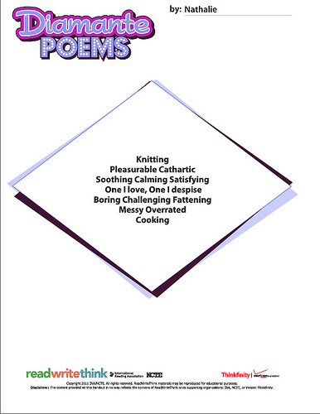

Slide 64
Narrative Poetry
Narrative poetry is a poem that tells a series of events using poetic devices such as rhythm, thyme, compact language, and attention to sound. Elements found in narrative poetry are character, setting, conflict, and plot.

Slide 65
Limerick Examples
lim·er·ick/lim(ə)rik/
A humorous, frequently bawdy, verse of three long and two short lines rhyming aabba, popularized by Edward Lear.
There was an Old Man of Nantucket Who kept all his cash in a bucket. His daughter, called Nan, Ran away with a man, And as for the bucket, Nantucket. - Anonymous
There was a young lady of Lucca Whose lovers completely forsook her; She ran up a tree And said "Fiddle-de-dee!" Which embarrassed the people of Lucca. - Edward Lear
There was a Young Lady whose chin Resembled the point of a pin: So she had it made sharp, And purchased a harp, And played several tunes with her chin. - Edward Lear
Few thought he was even a starter; There were many who thought themselves smarter, But he ended a PM CH and OM An earl and a Knight of the Garter. - Clement Attlee
There once was a man from Peru Who had a lot of growing up to do, He’d ring a doorbell, then run like hell, Until the owner shot him with a .22. - Anonymous
A bather whose clothing was strewed By winds that left her quite nude Saw a man come along And unless we are wrong You expected this line to be lewd. - Anonymous
There once was a young lady named bright Whose speed was much faster than light She set out one day In a relative way And returned on the previous night. - Anonymous
There was an old man with a beard Who said, "it’s just how I feared! Two owls and a hen Four larks and a wren Have all built their nests in my beard. - Anonymous

